Slide 1

An Enhanced Recommendation System Using Ensemble Learning Techniques (Aersuelt)
SET ID-221172
Name and Reg. No. Supervisor
Aman Kumar Sharma (22MCB0021) Mr. Parthasarathy G
Harsh Tyagi (22MCB0022) (19042) (SCOPE)
Rajat Moundekar (22MCB0004)
Date: 23/01/2023
Venue: SJT-409, VIT Vellore

Slide 2
CONTENTS
Objective
Introduction
Literature Survey
Proposed Work
Experiments and Results
Summary
References
VIT Vellore

Slide 3
OBJECTIVE
To build an efficient and enhanced recommendation system
using an hybrid model.

Slide 4
INTRODUCTION
Recommendation systems
People provide recommendations as inputs, which the system then aggregates and directs to appropriate recipients.
Major domains
Movie
Music
news
hotel
book
e-commerce and many other areas.

Slide 5
INTRODUCTION
There are mainly 3 types of recommendation system models
Collaborative Recommendation System
Content Based Recommendation System
Hybrid Recommendation system

Slide 6
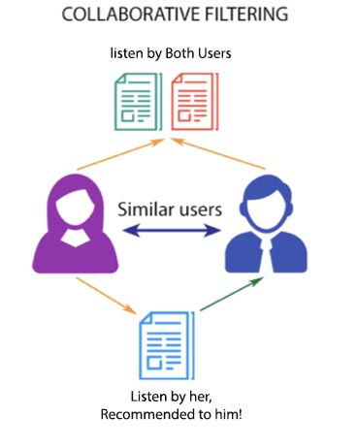
INTRODUCTION
Collaborative Recommendation System

Slide 7
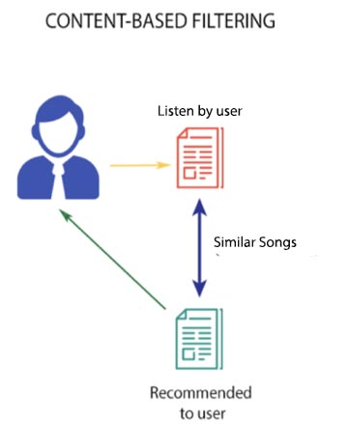
INTRODUCTION
Content Based Recommendation System

Slide 8
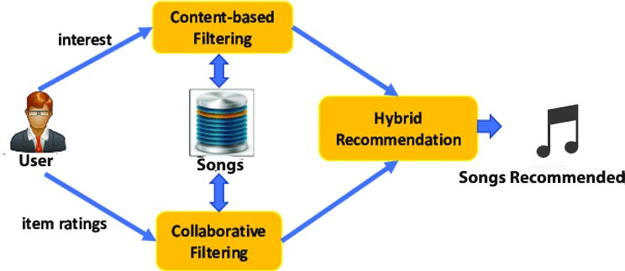
INTRODUCTION
Hybrid Recommendation System

Slide 9
LITERATURE SURVEY
Author & Year | Adopted Scheme | Features | Challenges
Ashish Patel et al. (2018) | incremental regression tree model and graph approach | Minimal error | heavily rely on client-server architecture which needs users to be online to get recommendations.
Elena Shakirova (2017) | collaborative filtering methods & evaluation metrics | High recall Reduced error | Cold start
Xixi Li et al. (2017) | weighted similarity | Reduced error | rationality needs to be further improved
M.Sunitha et al. (2014) | clustering and association mining | Avoid Cold start Improves quality of recommendation | High Execution time

Slide 10
LITERATURE SURVEY
Author & Year | Adopted Scheme | Features | Challenges
Monali Gandhi et al. (2014) | association mining and collaborative filtering | Avoid Cold start Improves quality of recommendation | High Execution time
Satya Prakash Sahu et al. (2017) | Naïve Bays | Sparsity Handling | Not precise method
Mohammadsadegh Vahidi et al. (2021) | CBRSs and collaborative filtering as well as clustering techniques and DNN | more accurate than any other methods used before | Execution and processing time of the proposed method are longer
Pasquale Lops, et al. | CBF | Learning оf рrоfile is made easy, Quality improves оver time, Соnsiders implicit feedbасk | does not completely overсоme the рrоblem of over-sрeсiаlizаtiоn and serendipity.

Slide 11
PROBLEM STATEMENT
According to the literature review, the following difficulties still persist in RS.
1. Scalability(Unable to handle large scale datasets)
2. Cold Start(Arises when no information is found about the user or item in the system)
A hybrid recommendation approach is proposed to address the aforementioned concerns.

Slide 12
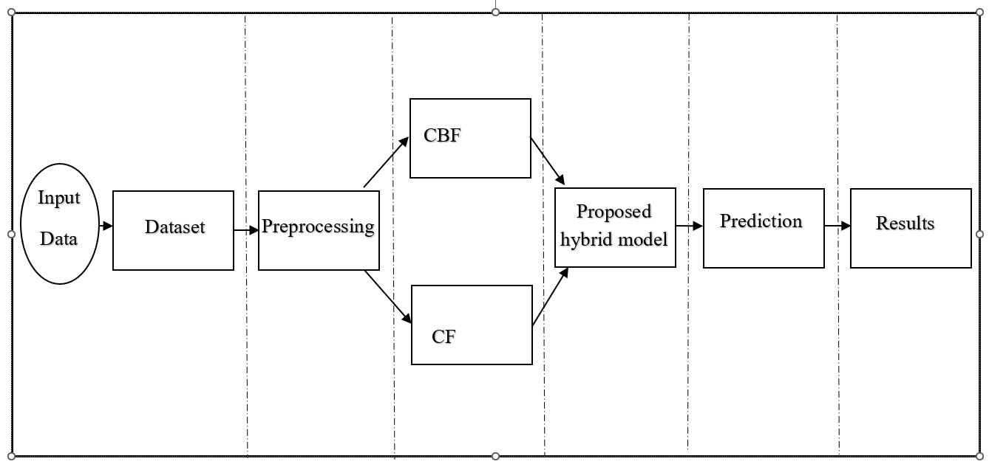
Proposed System

Slide 13
Dataset
Dataset | Users(Unique) | Songs(Unique) | Total data
Million Songs | 71798 | 3778 | 720945

Slide 14
Experiments and Results
Preprocessing
Sl. No. | Description | Dataset | Description
1. | Data Cleaning | Million song Dataset | Changing Layout Remove duplicate or irrelevant observations.
2. | Data Integration | Million song Dataset | Integrated as a single file to process
3. | Label Encoding | Million song Dataset | Converting Labels in numerical form

Slide 15
Experiments and Results
Data Visualization

Slide 16
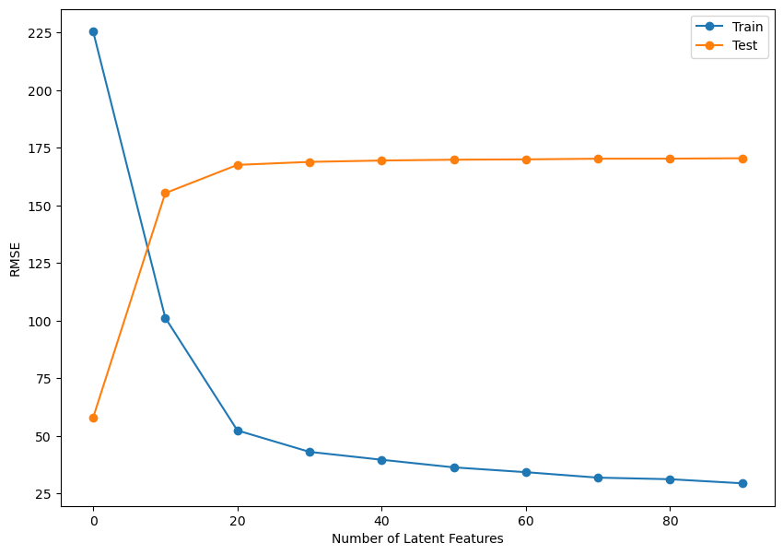
Experiments and Results
Collaborative Recommendation System

Slide 17
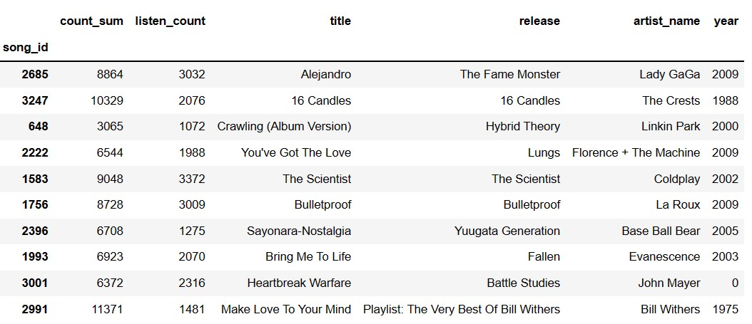
Experiments and Results
Collaborative Recommendation System

Slide 18
Experiments and Results
Collaborative Recommendation System
Model | Dataset | RMSE Score
SVD Model-Based Collaborative | Million songs Dataset | 0.0296
The RMSE is low which implies that the majority of predicted ratings are close to the actual ratings.

Slide 19
Experiments and Results
Collaborative Recommendation System
Model | Dataset | K | Mean Precision | Mean Recall
SVD Model-Based Collaborative | Million songs | 10 | 0.1776 | 0.0400
SVD Model-Based Collaborative | Million songs | 20 | 0.1433 | 0.0640
SVD Model-Based Collaborative | Million songs | 30 | 0.1298 | 0.0865
SVD Model-Based Collaborative | Million songs | 40 | 0.1170 | 0.1034

Slide 20
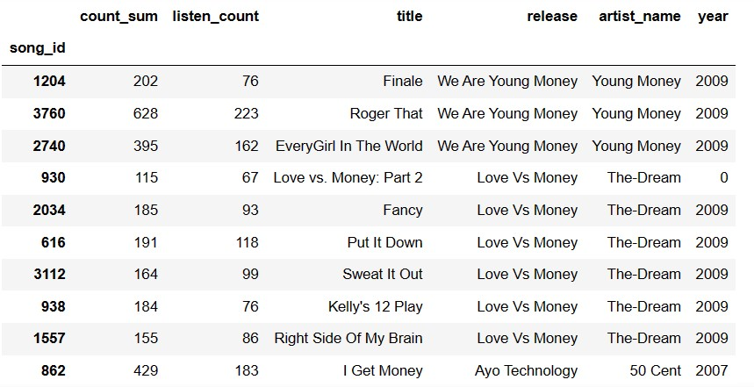
Experiments and Results
Content-Based Recommendation System

Slide 21
Experiments and Results
Content-Based Recommendation System
Model | Dataset | K | Mean Precision | Mean Recall
Content-Based Model | Million songs | 10 | 0.0546 | 0.0618
Content-Based Model | Million songs | 20 | 0.0521 | 0.1183
Content-Based Model | Million songs | 30 | 0.0496 | 0.1677
Content-Based Model | Million songs | 40 | 0.0461 | 0.2068

Slide 22
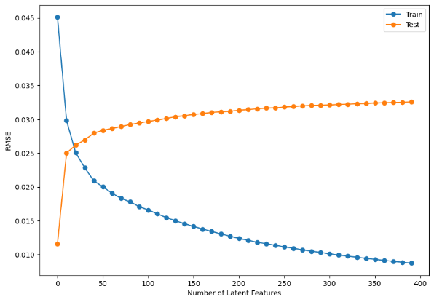
Experiments and Results
Hybrid Recommendation System

Slide 23
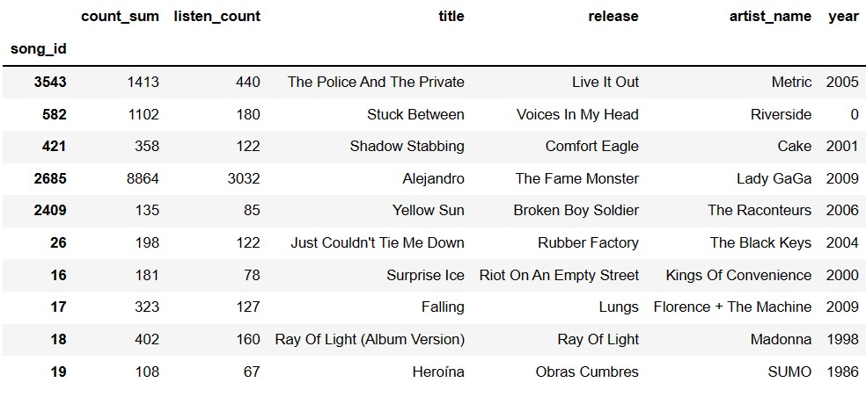
Experiments and Results
Hybrid Recommendation System

Slide 24
Experiments and Results
Hybrid Recommendation System
Model | Dataset | RMSE Score
Hybrid Model | Million songs | 0.0299
SVD Model-Based Collaborative | Million songs | 0.0296
The RMSE is low which implies that the majority of predicted ratings are close to the actual ratings

Slide 25
Experiments and Results
Hybrid Recommendation System
Model | Dataset | K | Mean Precision | Mean Recall
Hybrid Model | Million songs | 10 | 0.016186 | 0.0174
Hybrid Model | Million songs | 20 | 0.013225 | 0.0277
Hybrid Model | Million songs | 30 | 0.010544 | 0.0327
Hybrid Model | Million songs | 40 | 0.008829 | 0.0359

Slide 26
Summary
As per the Proposed System, we have implemented a CBF, CF, and hybrid recommendation system in our million songs dataset. In the hybrid, we have combined content-based and collaborative filtering and also, we have tested all models with our dataset. The results show hybrid model performed well and also, we addressed the issues of scalability through collaborative recommendation system and cold start through a content-based recommendation system.

Slide 27
References
[1] A. Patel and R. Wadhvani, "A Comparative Study of Music Recommendation Systems," 2018 IEEE International Students' Conference on Electrical, Electronics and Computer Science (SCEECS), Bhopal, India, 2018, pp. 1-4
[2] E. Shakirova, "Collaborative filtering for music recommender system," 2017 IEEE Conference of Russian Young Researchers in Electrical and Electronic Engineering (EIConRus), St. Petersburg and Moscow, Russia, 2017, pp. 548-550
[3] T. Hornung, C. -N. Ziegler, S. Franz, M. Przyjaciel-Zablocki, A. Schätzle and G. Lausen, "Evaluating Hybrid Music Recommender Systems," 2013 IEEE/WIC/ACM International Joint Conferences on Web Intelligence (WI) and Intelligent Agent Technologies (IAT), Atlanta, GA, USA, 2013, pp. 57-64
[4] Li, Xixi et al. “A Hybrid Recommendation Method Based on Feature for Offline Book Personalization.” ArXiv abs/1804.11335 (2018)

Slide 28
References
[5] M.Sunitha Reddy, T.Adilakshmi, V.Swathi, “A Novel Association Rule Miming and Clustering based hybrid method for Music Recommendation System”, International Journal of Research in Engineering and Technology ,Vol 3,Issue 5 ,May 2014, pp 55-59.
[6] Monali Gandhi , Khushali Mistry, Mukesh Patel , “ A Modified Approach towards Tourism Recommendation System with Collaborative Filtering and Association Rule Mining”, International Journal of Computer Application, Vol 91, No 6, April 2014, pp 17-21.
[7] Anand Nautiyal & Satya Prakash Sahu, Mahendra Prasad, “Machine Learning Algorithms for Recommender System - a comparative analysis,” 2017 International Journal of Computer Applications Technology and Research. 6. 97-100. 10.7753/IJCATR0602.1005.
[8] Vahidi Farashah, M., Etebarian, A., Azmi, R. et al. A hybrid recommender system based-on link prediction for movie baskets analysis. J Big Data 8, 32 (2021).
[9] Lops, P., de Gemmis, M., Semeraro, G. (2011). Content-based Recommender Systems: State of the Art and Trends. In: Ricci, F., Rokach, L., Shapira, B., Kantor, P. (eds) Recommender Systems Handbook. Springer, Boston, MA

Slide 29
References
[10] Aggarwal Charu C.. 2016. Recommender Systems the Textbook. Springer International Publishing.
[11] Scikit-learn: Machine Learning in Python, Pedregosa et al., JMLR 12, pp. 2825-2830, 2011
[12] http://millionsongdataset.com/ last accessed on 20.10.2022
[13] https://towardsdatascience.com/recommendation-systems-explained-a42fc60591ed
last accessed on 05.11.2022
[14] https://analyticsindiamag.com/a-guide-to-building-hybrid-recommendation-systems-for-beginners/ last accessed on 08.11.2022
[15] https://towardsdatascience.com/brief-on-recommender-systems-b86a1068a4dd last accessed on 12.12.2022
[16] https://www.tableau.com/learn/articles/datavisualization#:~:text=The%20importance%20 of%20data%20visualization,of%20their%20level%20of%20expertise. last accessed on 21.12.2022

Slide 30
References
[17] https://towardsdatascience.com/recommender-system-singular-value-decomposition-svd-truncated-svd-97096338f361 last accessed on 08.01.2023
[18] https://www.capitalone.com/tech/machine-learning/understanding-tf-idf/ last accessed on 08.01.2023
[19] https://en.wikipedia.org/wiki/Cosine_similarity last accessed on 08.01.2023

Slide 31
Queries

Slide 32
Thank You

